Slide 1

Data Renaissance : Amazon QuickSight & Generative BI
Chandrasekar Rajendran

Slide 2
What is Data Renaissance ?
Data Renaissance refers to a transformative period in which data-driven innovation, AI, and advanced analytics are reshaping industries, decision-making, and business models and with the rise of AI-driven insights, like Generative BI, allows for more intuitive data exploration without requiring technical expertise

Slide 3
Amazon Q in QuickSight
Amazon Q integrates with Amazon QuickSight to give QuickSight users access to a suite of new Generative BI capabilities. With Amazon Q in QuickSight, you can utilize the Generative BI authoring experience, create executive summaries of your data, ask and answer questions of data, and generate data stories
Powered by Amazon Bedrock: Amazon Q in QuickSight is built on Amazon Bedrock and includes automated abuse detection implemented in Amazon Bedrock to enforce safety, security, and the responsible use of AI.
Natural Language Query is a powerful new data tool that can speed insight discovery when integrated into the BI suite. New Amazon QuickSight Q capabilities help existing analytics authors to do more with NLQ.

Slide 4
Client Requirements
A line chart that shows the trend of loan organizations over time, with a forecast that estimates future loan origination volumes.
A donut chart that shows the distribution of loan amounts by grade.
A box plot chart that shows the distribution of loan amounts across different loan purposes.
A geospatial map chart that shows the loan amount distribution by state.
Conditional formatting applied to the geospatial map chart to highlight different loan amount ranges.
A Sankey diagram that shows the relationship between loan purpose and loan status.
A calculated field for age group created using Generative BI capabilities.
A virtual bar chart that shows the relationship between age groups and loan amounts.

Slide 5
How to create a Gen BI Dashboard ?
Data Ingest
Data Prep
Create a New Topic
Choose Analyses
Link Topic to Analyses
Build Visuals using Amazon Q
Amazon QuickSight

Slide 6
Gen BI Dashboard Outputs
Executive Summary
Data Story
Data Insights
Amazon QuickSight

Slide 7
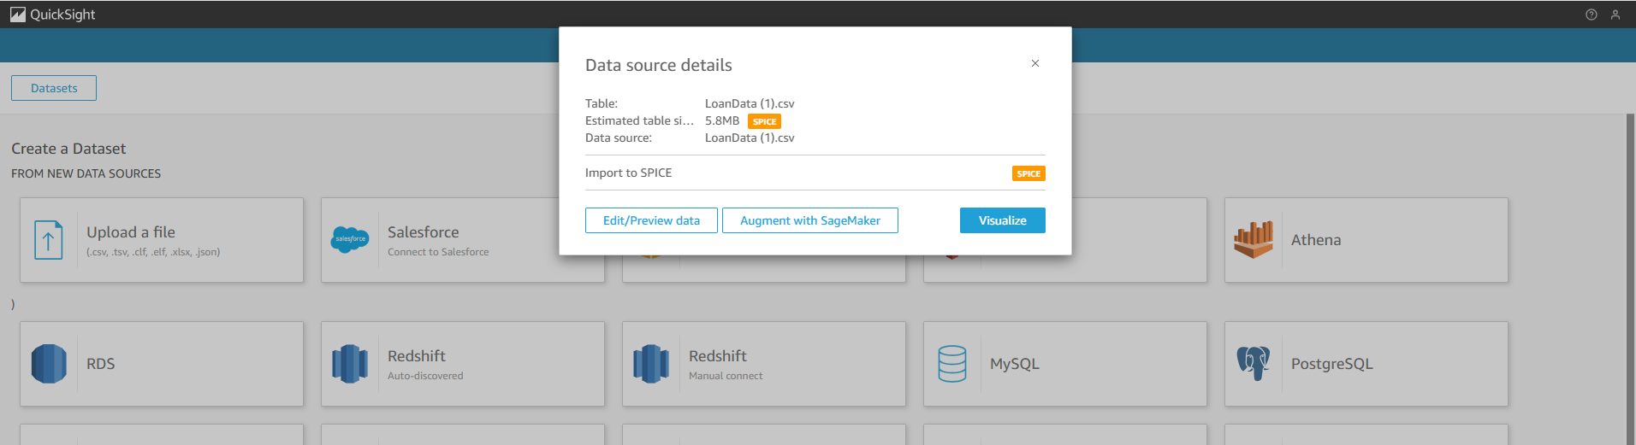
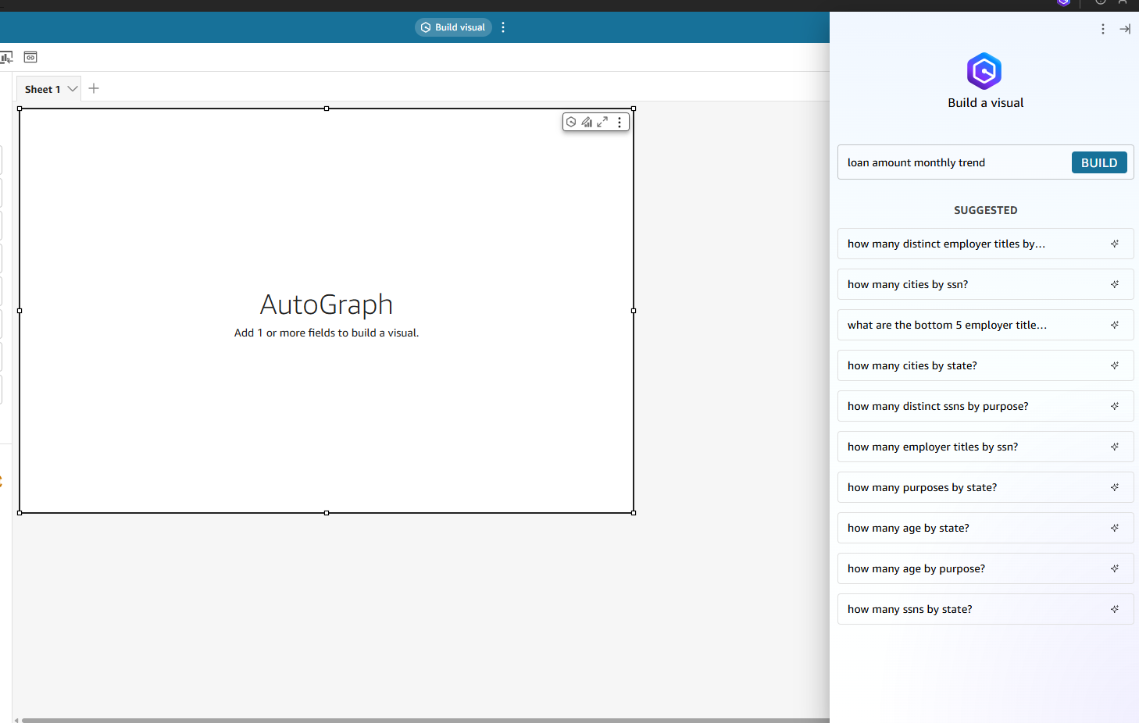
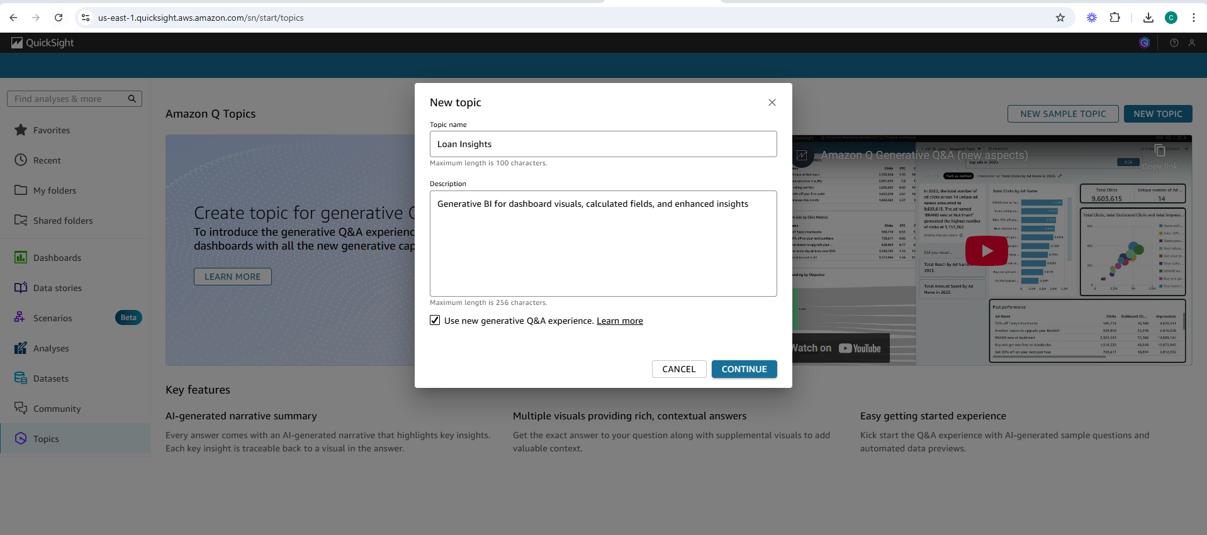
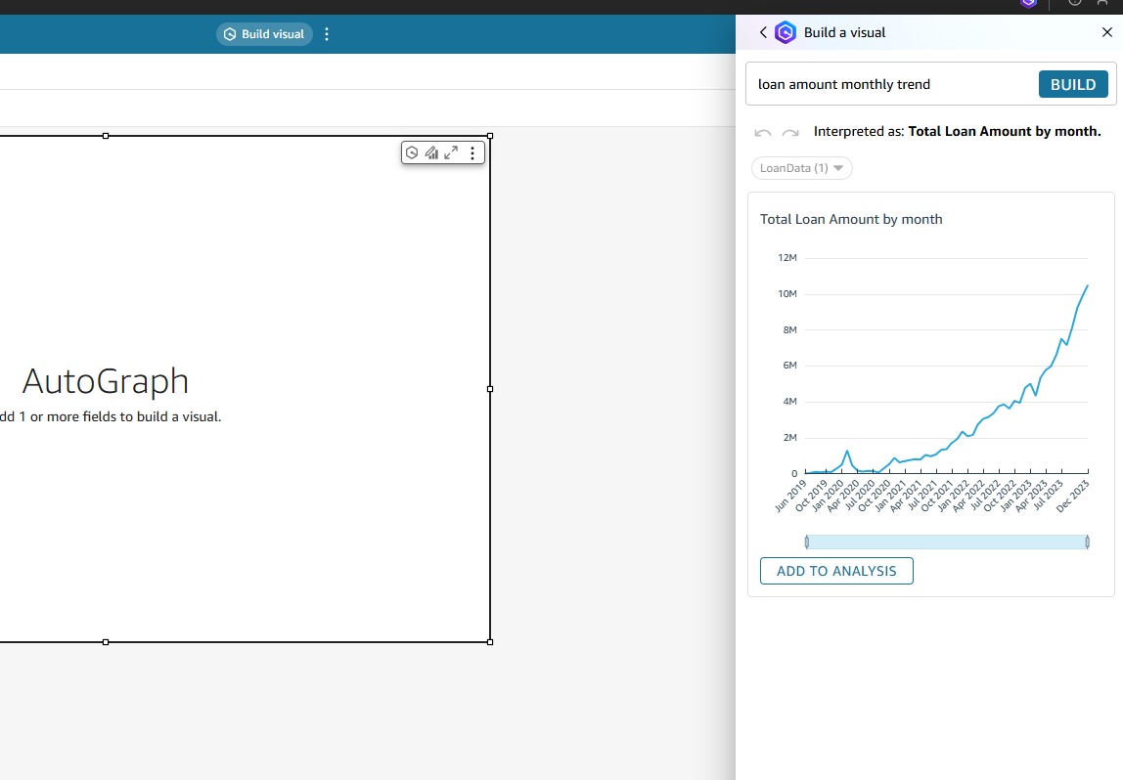
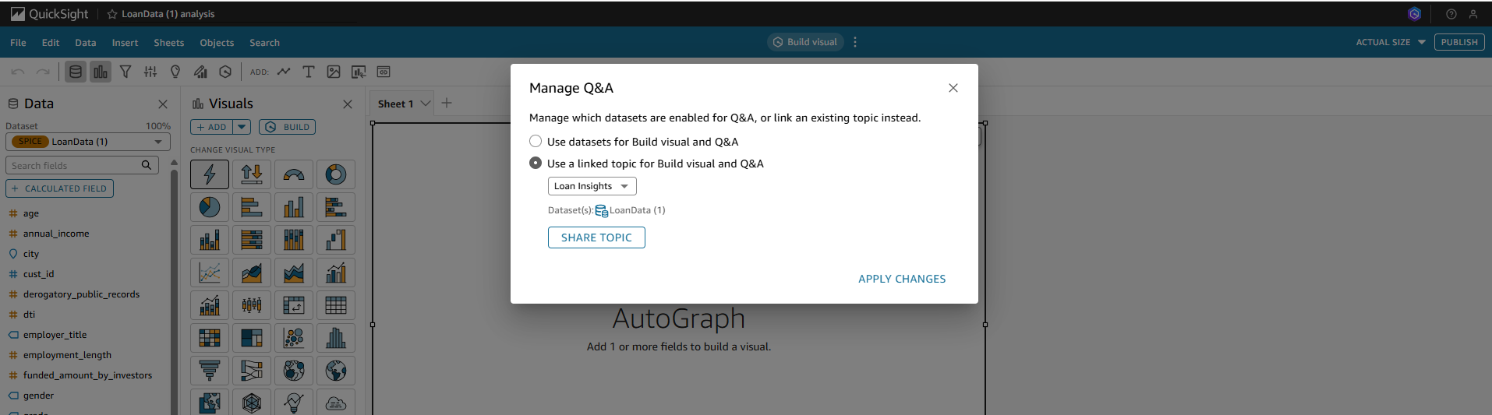
Build with Amazon QuickSight

Slide 8
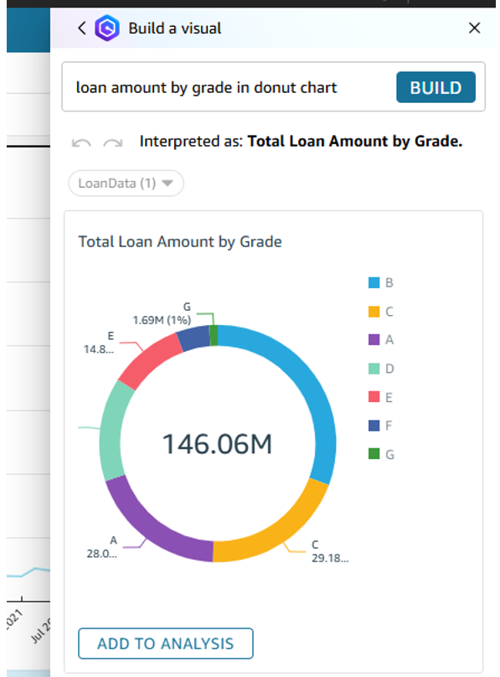
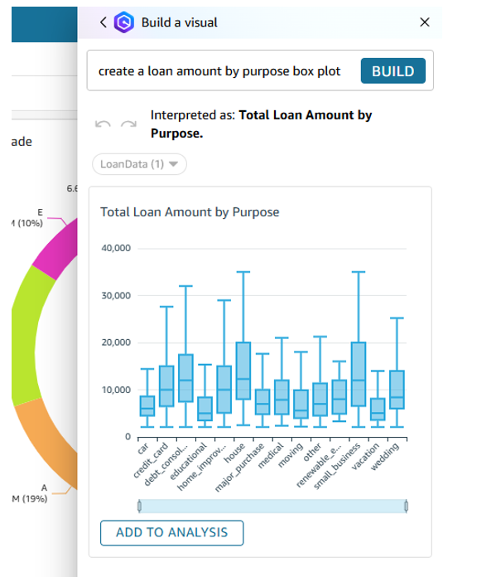
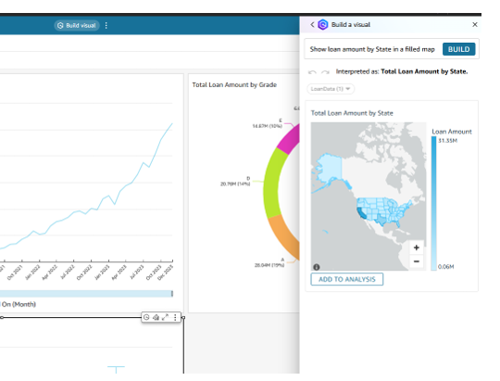
Build with Amazon QuickSight
Use Amazon Q to build dashboards by using Natural Language

Slide 9
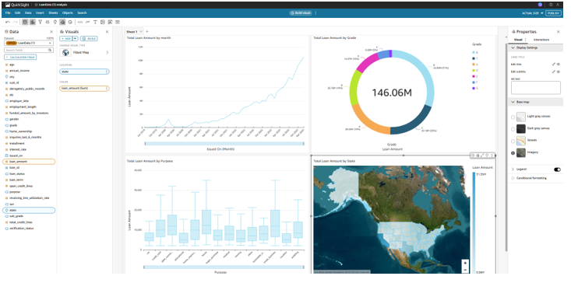
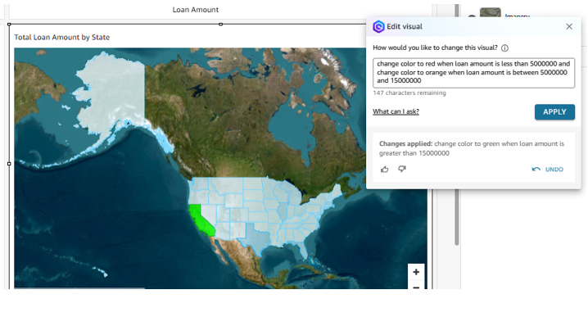
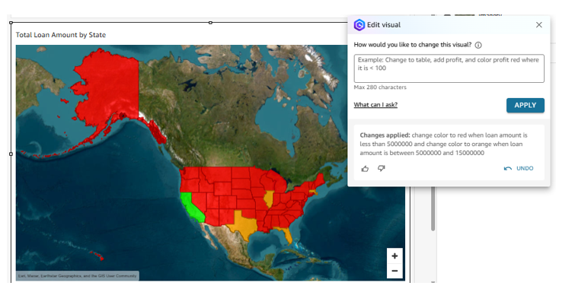
Build with Amazon QuickSight
Edit dashboards with Natural Language based on Data Filters

Slide 10
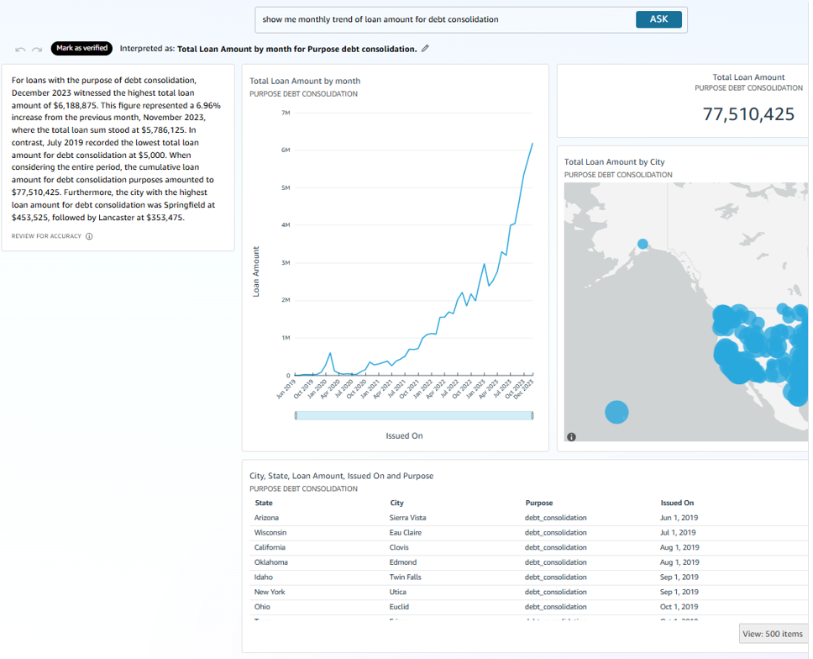
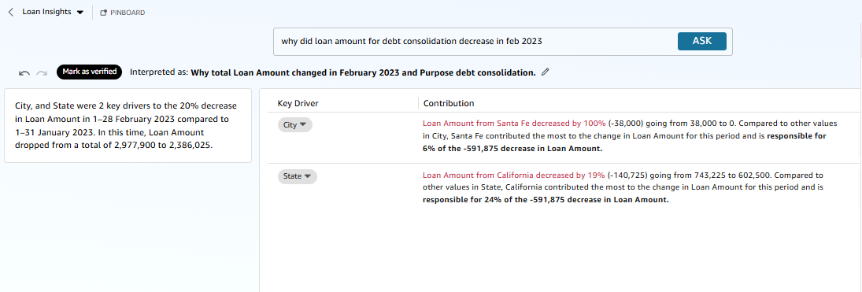
Interact with Dashboard
Ask Questions and get insights from Dashboard through Natural Language

Slide 11
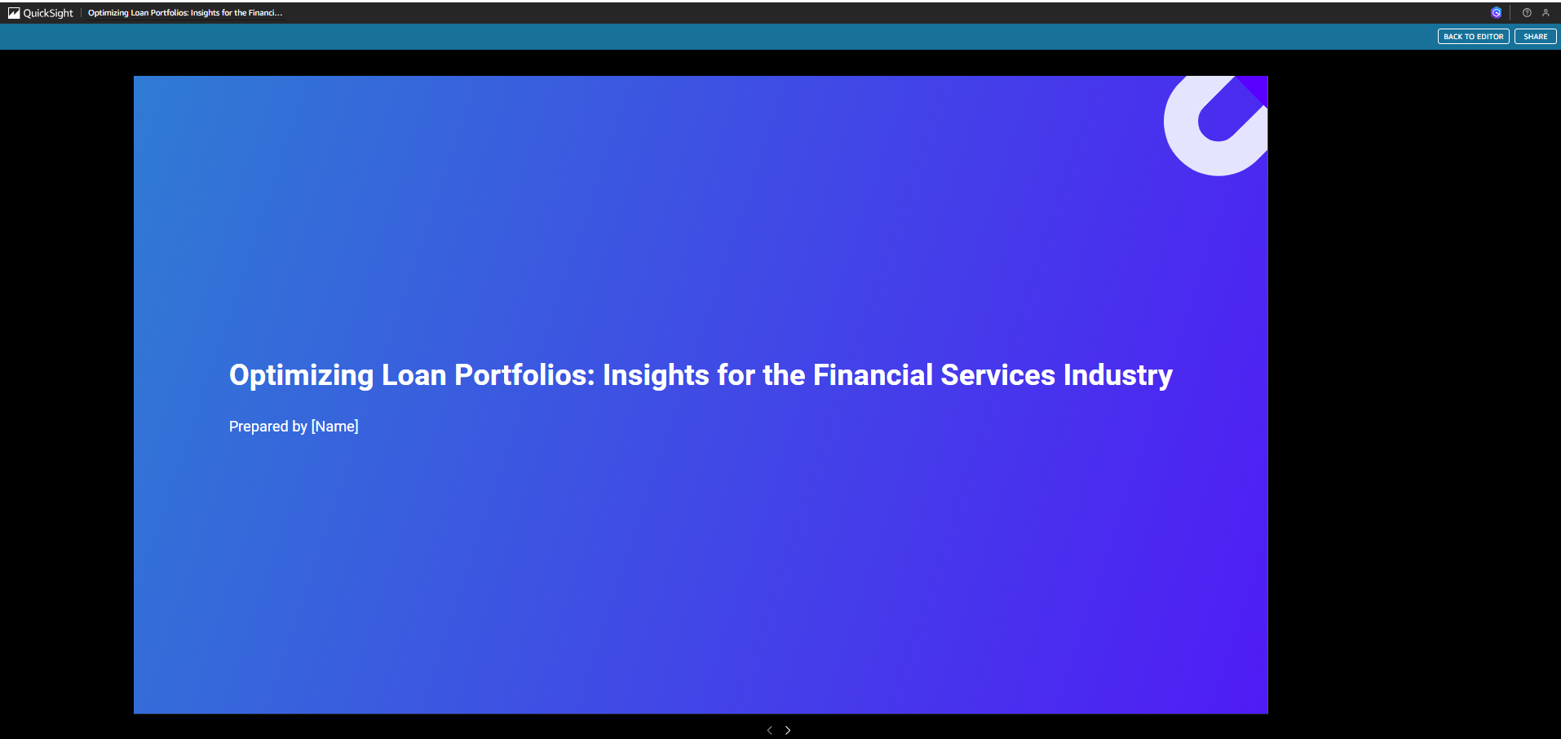
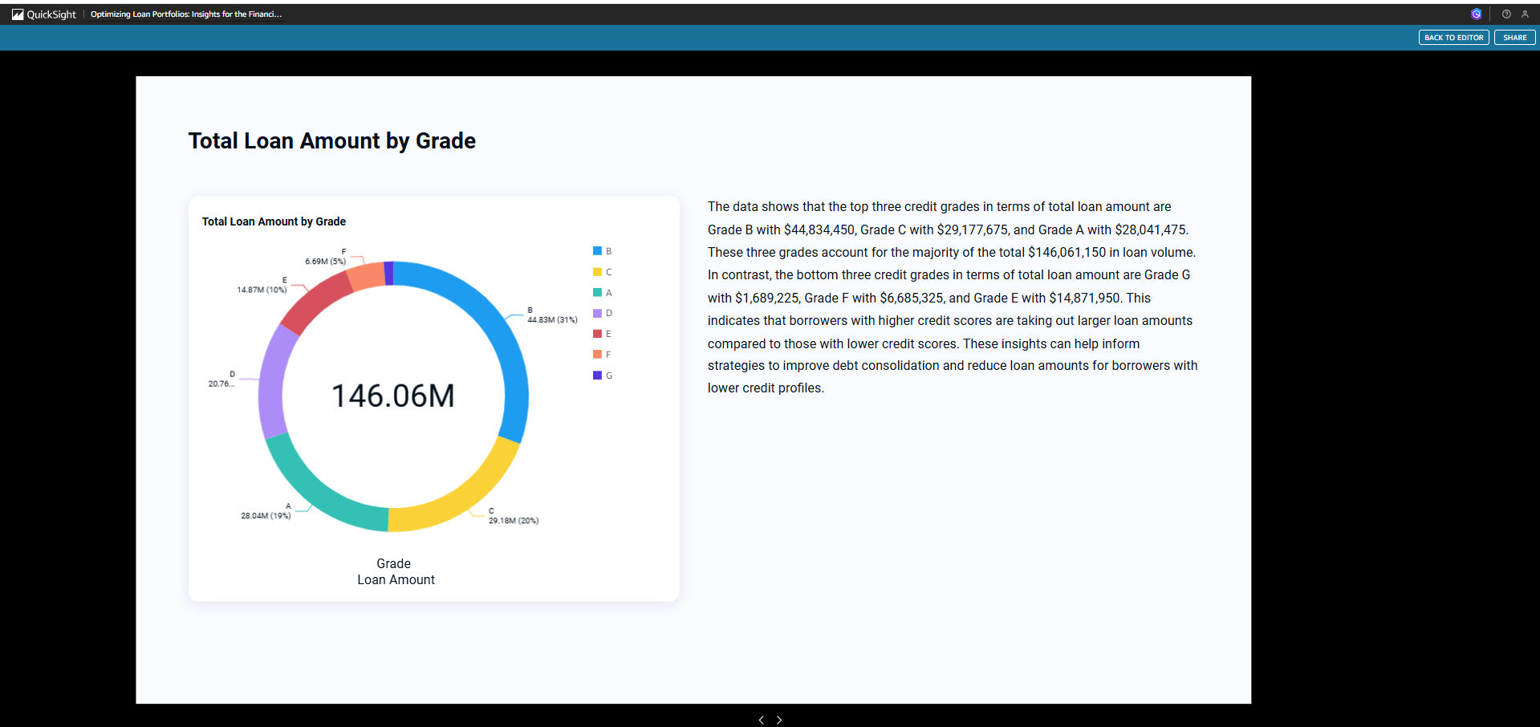
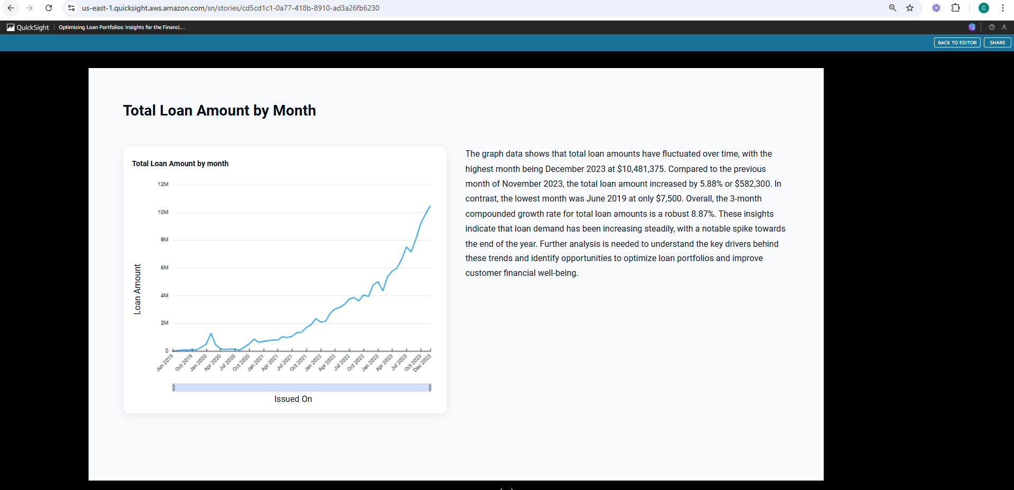
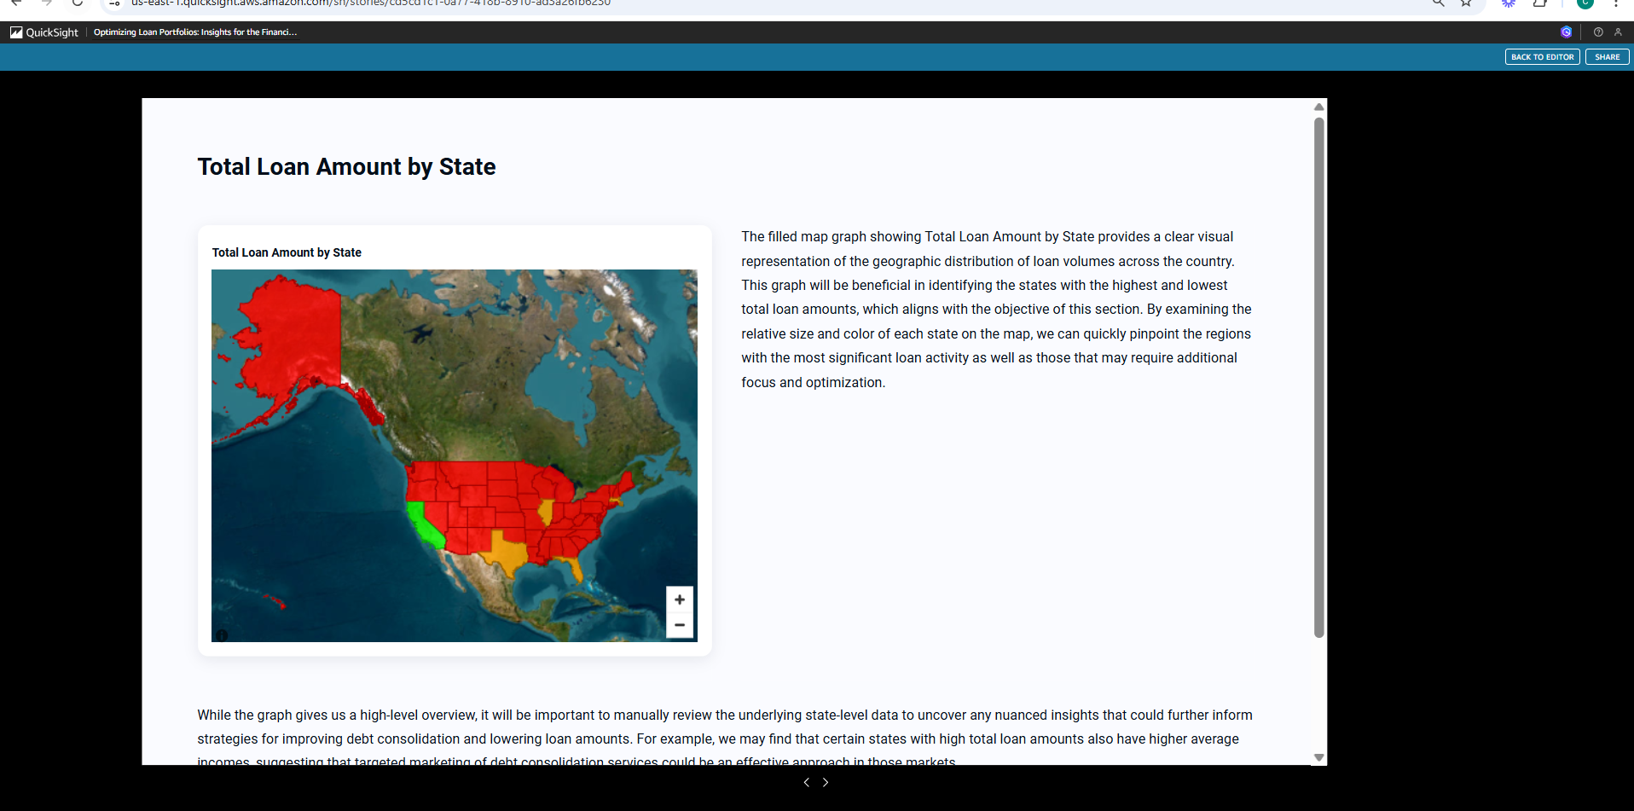
Create a Data Story
Create a Compelling Data Story to share with your business / stakeholders with Insights and Recommendations

